Slide 1
Model-based Integrated Planning and Control of Autonomous Vehicles using Artificial Potential Fields with uncertain environment
Emilio Benenati
Josyula Viswanath Das
8th October 2021

Slide 2
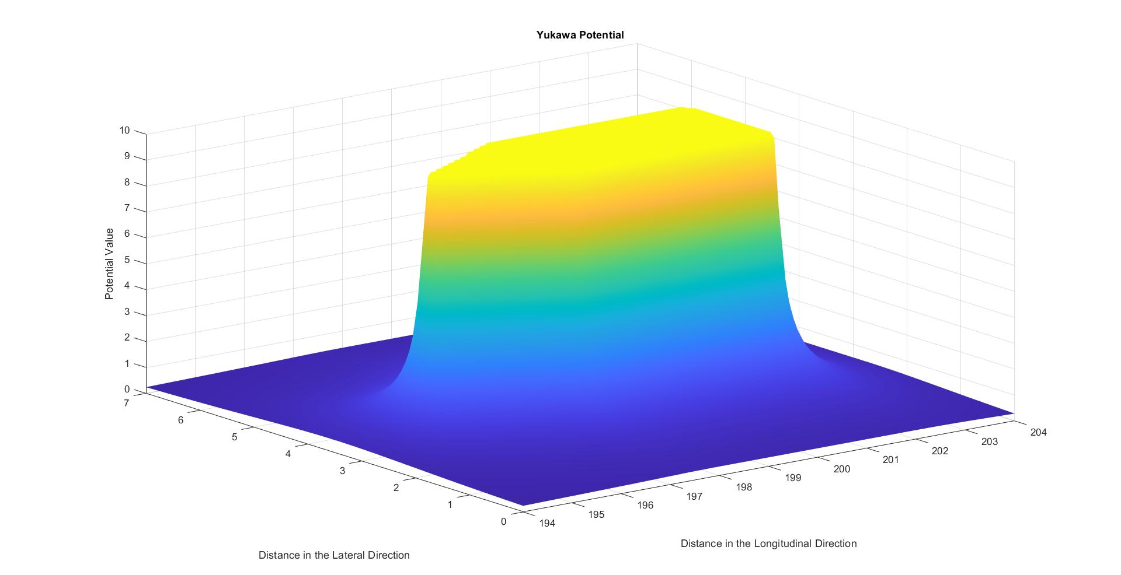
Yukawa Potential

Slide 3
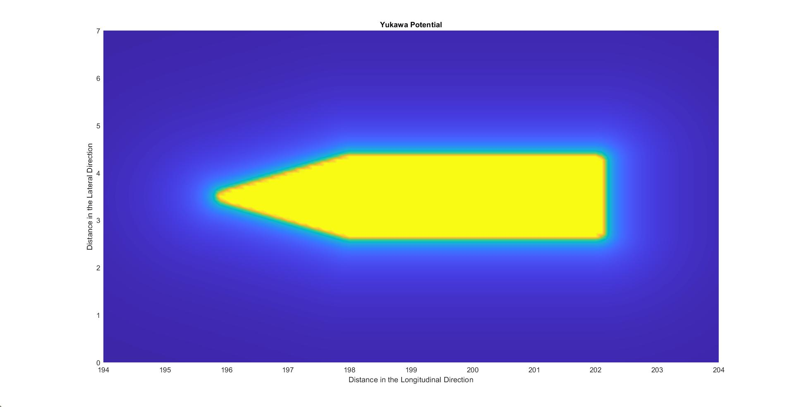

Slide 4
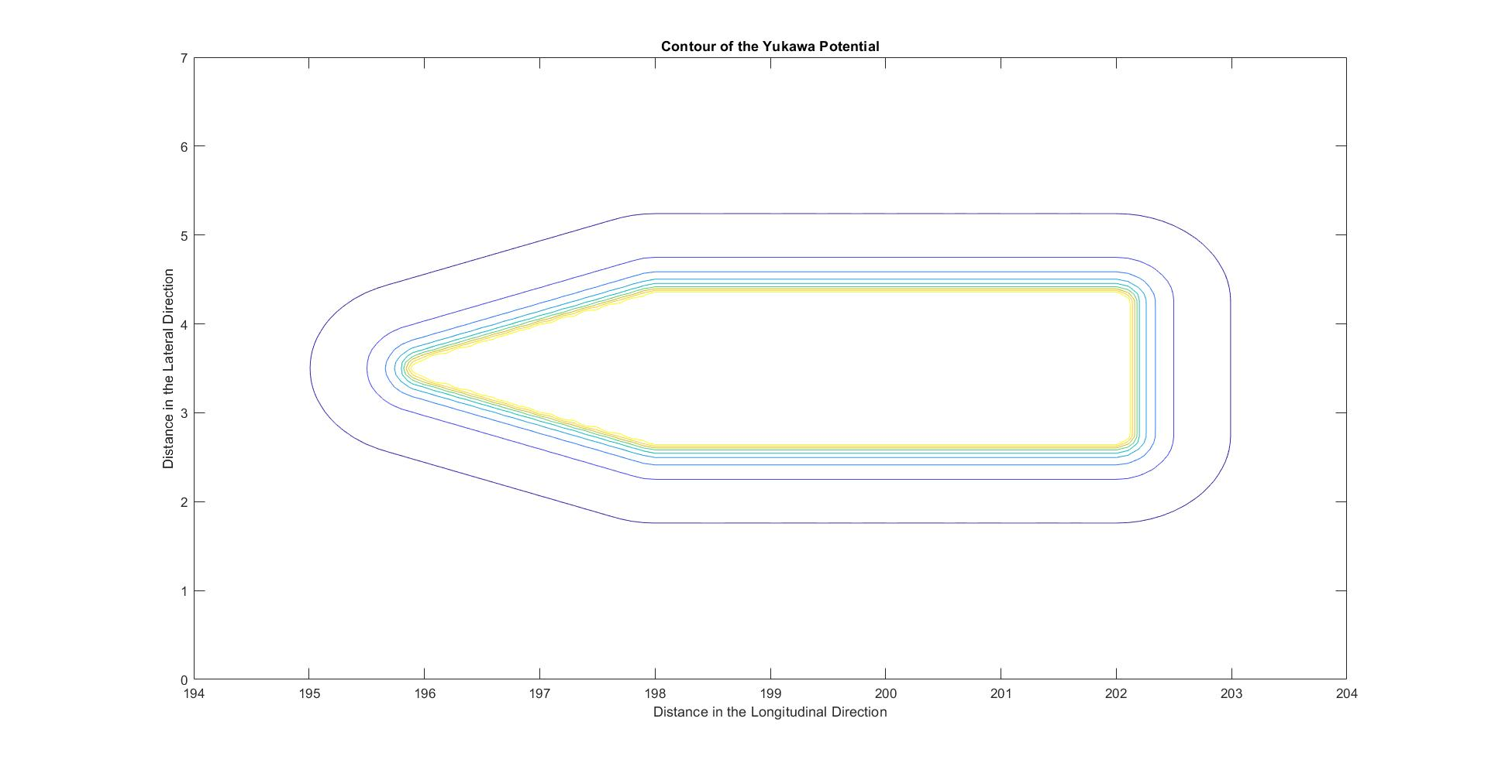

Slide 5
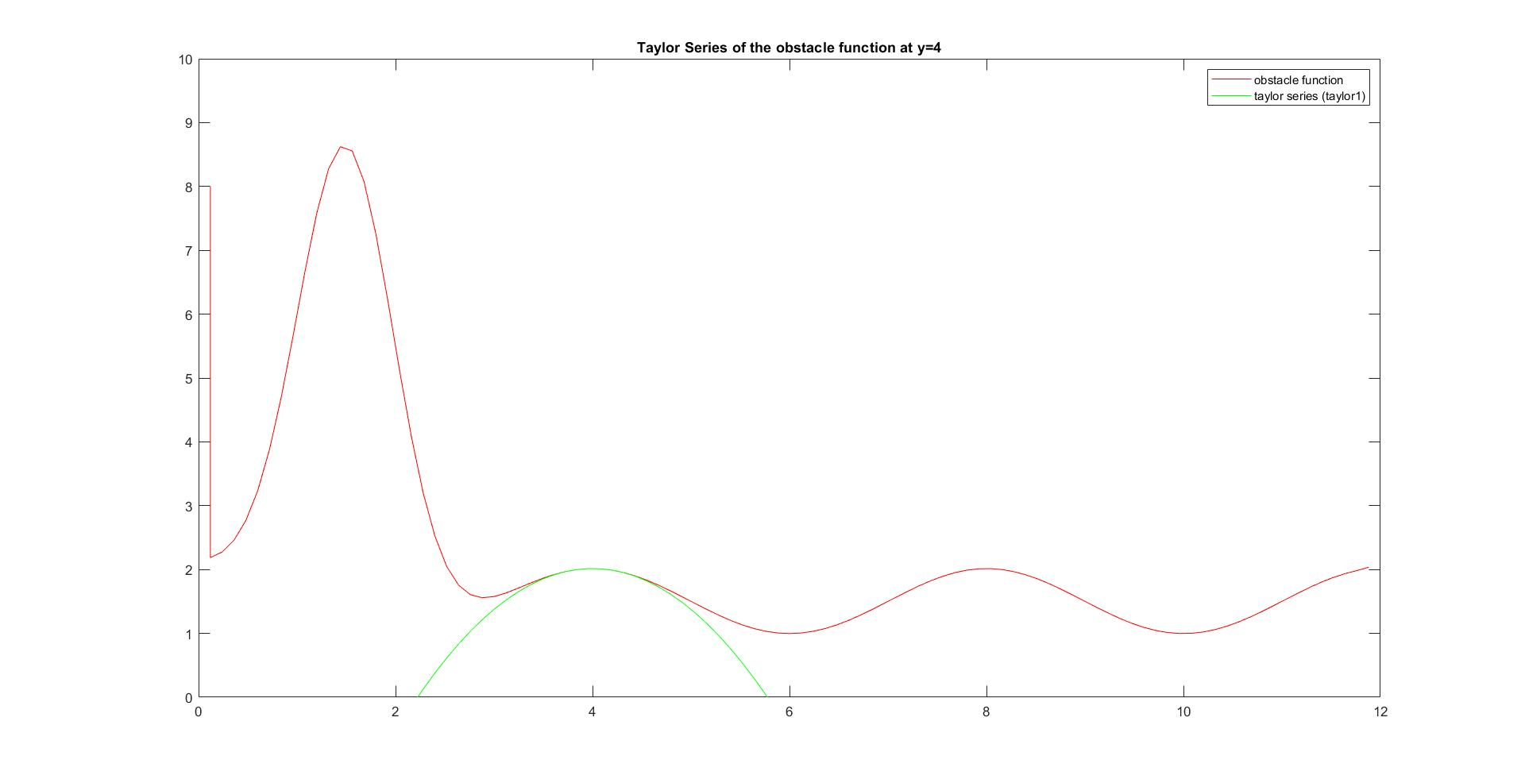
Cannot Use the lane potentials

Slide 6
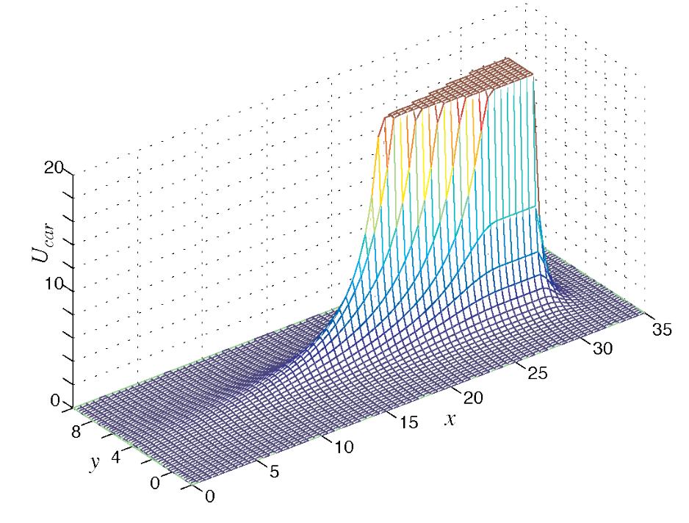




Slide 7











